Slide 1
Artificial intelligence IX
Mária Markošová

Slide 2
Last lecture
Stationary time series and Box – Jenkins models.
AR, MA, ARMA model, AR model coefficients via least square method.
Lag operators.
Creation and testing of the Box – Jenkins modeling.
Short insight into the nonlinear time series

Slide 3
Outline
What is dynamical system
Markovian processes modelled by the Bayesian networks.
Time series with uncertainty example.
Prediction, filtering, monitoring tasks, solutions.
Viterbi algorithm and Kalman filtering.

Slide 4
Let us recall
Bayesian network is a model which represents joint probability distribution in the probabilistic domain.
To calculate the joint probability with a help of the Bayesian network, Bayes net rule is used:

Slide 5
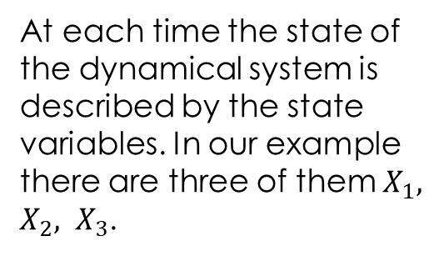
New concept: dynamical system
At each time the state of the dynamical system is described by the state variables. In our example there are three of them $X_{1}, X_{2}, X_{3}$.
State at time t
State at time t+m
Trajectory in the state space
In physics, dynamical system is a system which changes its state with time. On fig, there is a dynamical system in a three dimensional space.

Slide 6
Dynamical system
In some situations it is not possible to measure the state vector X directly, but some other measurable variable E is measured. There is a probabilistic dependence of E and X.
There are situations, that even the state can be specified only with certain probability.
E(t)

Slide 7
Examples:
Sun temperature is measured with a help of the sun radiation on certain wave
lengths in the spectrum.
Whether our body is in a good health is measured with a help of several
chemicals and their concentration in a blood.
Robot, agent., machinery state can be read with a help of several control
signals.
But: - higher radiation can be caused by other reasons, by higher solar activity, not only by the
temperature changes
- different concentration of chemicals in the blood can be caused also by the current
stress or other reason, not only by illness
- control signal can be sometimes seen if something is wrong with the control system, not
necessarily with the robot or machinery
That means, the relation between state variable and the measured variable is often probabilistic, not deterministic

Slide 8
1. Measurable variable and the state variable are related by the probabilistic relation.
2. Change of the evidence variable (the measurable one) are only with certain probability caused by the change of the state variable.
3. If the evidence variable E measures the state of the system X in discrete time units, we get the time series .

Slide 9
Dynamical system - summary
Dynamical system is a systems which is changing with time.
It is described by the series of the state variables (state vector) .
Some of the state variables are observable directly, the time dependence of the others is estimated indirectly with a help of evidence (observable, measurable) variables.
Observations can be noisy.
Question: Is some reasoning about the time series possible also in this case ? Can we, for example , predict next time behavior of the time series?

Slide 10
Changes of the dynamical system with time are represented by the series of state variables at the time units, time series.
We suppose:
- at each time moment we have a set of observable and a set of
unobservable variables
- unobservable state variable (vector) at the time t
- evidence, observable variable (vector) at time t
. - measured value of
- sequence :

Slide 11
Example:
Security guard stationed at the secret underground installation wants to know whether it rains outside. He has no contact with the outside world (cannot measure the outside state directly). The only access to the outside world occurs each morning, when he sees the director coming in with or without umbrella.
For each day t we have one evidence variable (U = umbrella ) , one state unobservable variable s (R: rain) . Both of them are Boolean variables, can have values 1 if it rains and 0 otherwise for example.

Slide 12
Assumption: State sequence starts at the time v t=0, the observed one at the time t=1.
Our umbrella world is represented by the two time sequences (time series):
1. State variable sequence :
Evidence variable sequence :

Slide 13
Questions:
Is there a dependence between the states t+1 and t?
If yes, how many previous states one needs to take into account for further reasoning?
Let us suppose:
Proces is stationary: state changes are caused by the laws that do not change over time themselves .
Markovian assumption: Current state depends only on the finite number of the previous states.
P

Slide 14
Markovian processes (MP) of the first order:
MP of the first order : Current state depends only on the closest previous state
„transition model“ of the first order
Time development of the states is completely described by this conditional probability.
Bayesian network of the first order MP.

Slide 15
2. Markovovian process of the second order :
Bayesian network of the second order MP
For Markovian processes it is wise to suppose, that the evidence variables at the time t depends only on the state variables at the time t .
One also needs to specify:
This conditional probability distribution is called senzor model, or markovian condition

Slide 16
Our Umbrella world example .
What we know?
It is a Marcovian process of the first order, so the state variable depends on only. Whether it rains at Thursday depends only on the rainy weather at Monday.
Markovian condition holds. Whether the director comes with an umbrella today is influenced only by the rain outside. So the measurable variable
is influenced by the state variable .
Draw the Bayesian network for the Umbrella world ( 1 grade to the exam for the first one).

Slide 17


Write a formula for the full joint probability distribution. (1 grade to the exam for the first one)
Umbrella world ☺: Bayesian network
Transition model
Sensor model
How the full tabs look like?

Slide 18
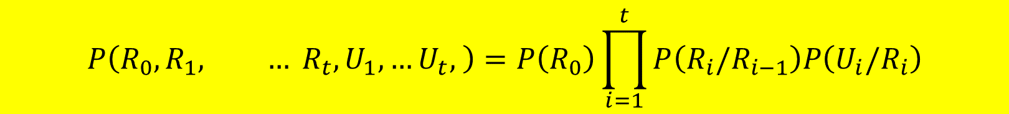
If in the markovian process is specified
transition model
senzor model
probability
Then the full joint probability distribution is given as :
$$P\left(R_{0}, R_{1}, … R_{t}, U_{1},…U_{t}, \right)=P\left(R_{0}\right)\prod_{i=1}^{t}{P\left(R_{i}/R_{i−1}\right)P\left(U_{i}/R_{i}\right)}$$

Slide 19

Markovian process 1. order
t
0.7
f
0.5
...
We have two values of the Boolean variable R:

Slide 20
Markovian process of the 1. order
...
Two values of the state random variable R:

Slide 21

$$P\left(R_{t−1}/R_{t}\right)$$
t
0.7
f
0.5
Solve the last question at home.
In fact we are solving the prediction task. If it rained at the time 0, will the rain continue?

Slide 22
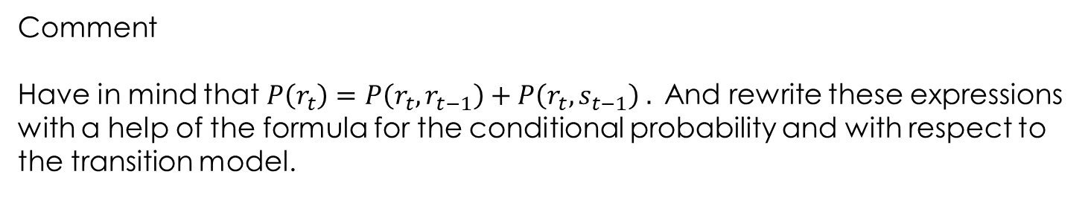
Comment
Have in mind that $P\left(r_{t}\right)=P\left(r_{t},r_{t−1}\right)+P\left(r_{t},s_{t−1}\right) .$And rewrite these expressions with a help of the formula for the conditional probability and with respect to the transition model.

Slide 23
Stationary distribution
What are the reasonable questions.
Does the limit exist?
Does the stationary solution exist?
This is a limit probability for the stationary distribution.

Slide 24
Inference in the time series with uncertainity.
Tasks :
Filtering, or monitoring:
Calculation of . In our „umbrella world“ it is a calculation of the rain probability today based on series of umbrella obrservations.
Observed values of
vector

Slide 25

Prediction:
Probability of the future state calculation providing we have observations to the current time.
We calculate the probability of rain in three days (k=3) having the series of observations till today.

Slide 26
Smoothing:
Calculation of the conditional probability of the past state on the basis of observations till the current state.
Calculation of the rain probability last Wednesday if we have observations of the umbrella appearance till today.

Slide 27
Finding the most likely sequence:
We have a given sequence of observations, we want to know the most likely state sequence leading to these observations.
For example:
If umbrella appears first three days and the fourth day it does not, the most likely state sequence explaining these observations is that there was rain for three days and the fourth day there was no rain.

Slide 28
Filtering (monitoring) and prediction
In a case of filtering we want to know:
observation division
used Bayes rule
markovian assumption used
Comment : Formula for the conditional probability and conditional independence is used.

Slide 29
We have:
This is in fact prediction:
Prediction update on the basis of the last observation. This factor is gained directly from the sensor model.
Filtering: prediction updated with respect to the last observation

Slide 30
One step prediction in the filtration formula:
Filtration formula reformulation:
-markovian hypothesis used
transition model current distribution of states
We used :

Slide 31
Preliminary summary
One step prediction
More step prediction:

Slide 32
„Umbrella world” example . B. net:
Tresor guard believes that:
Day 1. : Observation – umbrella appeared
-summary through the states till the current time

Slide 33
Day 2.: The umbrella appeared again so:
Prediction of the state from t=1 to t=2:
Filtering is the prediction update with respect to the observations for t=2.

Slide 34
Prediction is in fact filtration process without updating to a new observations. :

Slide 35
Smoothing: We calculate
- Bayes rule used
-notion of conditional independency used
This is in fact filtering
This we need to elaborate

Slide 36
Recursion formula
Markovian condition
Recursive element
Known from the model

Slide 37
Smoothing in the „umbrella world“
We want to know smoothed estimate of the rain probability at the time t=1, providing we have an observations of the umbrella appearance for the first two days za predpokladu (t=1,2) and we know that the umbrella appeared the first and the second day as well.
**
Known from the previous calculations
Gained by a recursive process

Slide 38
Recursion
Using the equation **:
Smoothed estimate is higher then the filtered estimate. The reason is that the rain has a tendency to continue for several days. Umbrella appearance at the day 2 signalized that the probability of the rain at the day 1 might be higher as estimated by filtering.

Slide 39
Time series with uncertainty – preliminary summary
Prediction:
Filtering:
Smoothing:

Slide 40
4. Most likely sequence and the Vitterbi algorithm
The meaning of the formula: Let us have certain observed sequence (true,true,false,true,true) the number of observations is t+1. We can find conditional probability for an arbitrary sequence of states . But we look for such sequence of states x, for which the probability is maximal providing the given observation sequence

Slide 41
Viterbi algorithm
true
true
true
true
true
false
false
false
false
false
Umbrella true true false true true
0.8182
0.5155
0.0361
0.0334
0.0210
0.1818
0.0491
0.1237
0.0173
0.0024

Slide 42
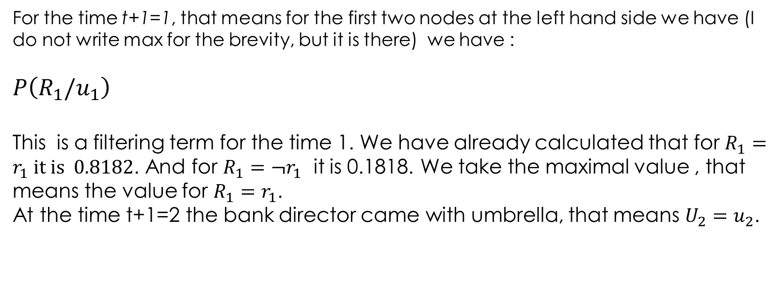
For the time t+1=1, that means for the first two nodes at the left hand side we have (I do not write max for the brevity, but it is there) we have :
$$P\left(R_{1}/u_{1}\right)$$
This is a filtering term for the time 1. We have already calculated that for $R_{1}=r_{1} it is 0.8182$. And for $R_{1}={¬r}_{1}$ it is 0.1818. We take the maximal value , that means the value for $R_{1}=r_{1}$.
At the time t+1=2 the bank director came with umbrella, that means $U_{2}=u_{2}$.

Slide 43
These are values for the second leftmost nodes in the graph. Alpha is already hidden here:
I strongly recommend to find the values for the third leftmost nodes in the state graph hodnoty. Take care, observation in this case is

Slide 44
Summary
Nonlinear processes and time series analysis.
Dynamical system, state space , trajectory
Time series with uncertainty (umbrella world example).
Markov process, Markov condition, Bayes nets for MP.
Prediction, filtering, smoothing and most likely sequence.

